Slide 1
LC-3 Assembly Language and the Assembler

Slide 2
Assembly Language
Assembling with an Assembler
Coding is exactly what we have been doing so far with a few additions.
Instructions: add, and, not, ld, st, ldr, str, etc …
Pseudo-ops: .orig, .fill, .blkw, .stringz, .end
Labels
Much easier for humans.
Addresses are often calculated automatically.
Computer does more work in the background.
; begins a comment
# is used to mean immediate

Slide 3
After homework 4, DO NOT CONVERT CODE TO HEX BY HAND!!!
Last week you created your assembly and then converted it by hand.
I wanted you to learn hex codes for ALL the operations.
But now, we are going to use the assembler.
THIS WEEK YOU SHOULD USE THE ASSEMBLER INSTEAD!!!
Write your code in assembly as described in the first part of these notes and save as an ASM file.
Load your program into the assembler. You can download it from the resources portion of AsULearn.
Load the program into the assembler and THE ASSEMBLER WILL CONVERT IT TO HEX.
The assembler will calculate offsets AND store data for you.

Slide 4
Assembly Code Label
The first column in an assembly program is used for labels.
A label is simply a way of telling the assembler to remember a specific memory location.
Labels can be used as positions for branching and jumping to subroutines (BR and JSR).
Labels can be used like variable names for loading and storing (LD, LDI, LEA, ST, STI).
The assembler will calculate the proper offsets for you using the label addresses. This only works for PCOffset instructions.

Slide 5
DO NOT USE OFFSETS after homework4!!!
After homework 4 you should NOT calculate or use any numerical offsets in your code!!!
LD, ST, BR, LEA, JSR
These are WRONG and WILL FAIL!!
LD R1, #5
BRN #-7
LEA R0, 5
JSR 100
CORRECT!! USE LABELS!! NO NUMBERS!!
LD R1, N48
BRN TOP
LEA R0, PROMPT
JSR GETNUM

Slide 6
Pseudo Ops – Assembler Directives
These are special instructions to the assembler, not part of the ISA.
.ORIG
specify the starting address
.FILL
Initialize a single memory location to some value
.BLKW - BLocK of Words
Reserve a block of memory locations
.STRINGZ
Reserve character memory as a string
Will be null terminated
.END
Tells the assembler where the program ends

Slide 7
.FILL and .BLKW
Save a whole range of memory.
Affects the next memory location.
.orig x3000
LEA R6, C
LD R0, A
HALT
A .fill 65
B .fill 66
C .BLKW 5
D .fill 68
.end
3000 |  | EC04
3001 |  | 2001
3002 |  | F025
3003 | A | 0041
3004 | B | 0042
3005 | C | 0000
3006 |  | 0000
3007 |  | 0000
3008 |  | 0000
3009 |  | 0000
300A | D | 0044

Slide 8
.STRINGZ
3000 | E002
3001 | F022
3002 | F025
3003 | 0048
3004 | 0065
3005 | 006C
3006 | 006C
3007 | 006F
3008 | 002C
3009 | 0020
300A | 0057
300B | 006F
300C | 0072
300D | 006C
300E | 0064
300F | 0021
3010 | 0000
3011 | 0005
.ORIG x3000
LEA R0, HELLO
PUTS
HALT
HELLO .STRINGZ "Hello, World!"
A .fill 5

Slide 9
Traps
Traps are system subroutines used for IO and halting.
Use the following instead of the trap in assembly language programs.
Instead of TRAP x20 use GETC
Instead of TRAP x21 use OUT
Instead of TRAP x22 use PUTS
Instead of TRAP x23 use IN (Don't use this one at all)
Instead of TRAP x24 use PUTSP (Don't use this one at all)
Instead of TRAP x25 use HALT
Using the TRAP x## instead of the word shown above will cost you points on the exam and quizzes.

Slide 10
A simple example - LABELS
 | .orig | x3000 | ; load the program to memory location x3000
 | LD | R0, A | ; load the value stored at A to register 0
 | LD | R1, B | ; load the value stored at B to register 1
 | NOT | R2, R1 | ; Invert R1 and store in R2 for making R2 = -R1
 | ADD | R2, R2, #1 | ; Add 1 to R2 for making R2 = -R1
 | ADD | R2, R2, R0 | ; R2 <- R0 – R1
 | BRN | L1 | ; Jump to L1 if R1 > R0
 | OUT |  | ; Print R0 to the screen since it was larger
 | BRNZP | END | ; Jump to end of program
L1 | ADD | R0, R1, #0 | ; Move R1 to R0
 | OUT |  | ; Print what was in R1 since it was larger
END | HALT |  | ; Halt the program
A | .fill | 35 | ; Variable A is just this memory location
B | .fill | 36 | ; Variable B is just this memory location
 | .end

Slide 11
A simple example - PSUEDO-OPS
 | .orig | x3000 | ; load the program to memory location x3000
 | LD | R0, A | ; load the value stored at A to register 0
 | LD | R1, B | ; load the value stored at B to register 1
 | NOT | R2, R1 | ; Invert R1 and store in R2 for making R2 = -R1
 | ADD | R2, R2, #1 | ; Add R1 to R2 for making R2 = -R1
 | ADD | R2, R2, R0 | ; R2 <- R0 – R1
 | BRN | L1 | ; Jump to L1 if R1 > R0
 | HALT |  | ; Print R0 to the screen since it was larger
 | BRNPZ | END | ; Branch to end of program
L1 | ADD | R0, R1, #0 | ; Move R1 to R0
 | OUT |  | ; Print what was in R1 since it was larger
END | HALT |  | ; Halt the program
A | .fill | 35 | ; Variable A is just this memory location
B | .fill | 36 | ; Variable B is just this memory location
 | .end

Slide 12
A simple example - TRAPS
 | .orig | x3000 | ; load the program to memory location x3000
 | LD | R0, A | ; load the value stored at A to register 0
 | LD | R1, B | ; load the value stored at B to register 1
 | NOT | R2, R1 | ; Invert R1 and store in R2 for making R2 = -R1
 | ADD | R2, R2, #1 | ; Add R1 to R2 for making R2 = -R1
 | ADD | R2, R2, R0 | ; R2 <- R0 – R1
 | BRN | L1 | ; Jump to L1 if R1 > R0
 | OUT |  | ; Print R0 to the screen since it was larger
 | BRNZP | END | ; Jump to end of program
L1 | ADD | R0, R1, #0 | ; Move R1 to R0
 | OUT |  | ; Print what was in R1 since it was larger
END | HALT |  | ; Halt the program
A | .fill | 35 | ; Variable A is just this memory location
B | .fill | 36 | ; Variable B is just this memory location
 | .end

Slide 13
Loops with Labels
;with labels
AND R0, R0, #0
AND R1, R1, #0
ADD R0, R0, #6
TOP
ADD R1, R1, R0
ADD R0, R0, #-1
BRP TOP
HALT
;without labels
AND R0, R0, #0
AND R1, R1, #0
ADD R0, R0, #6
ADD R1, R1, R0
ADD R0, R0, #-1
BRP #-3
HALT

Slide 14
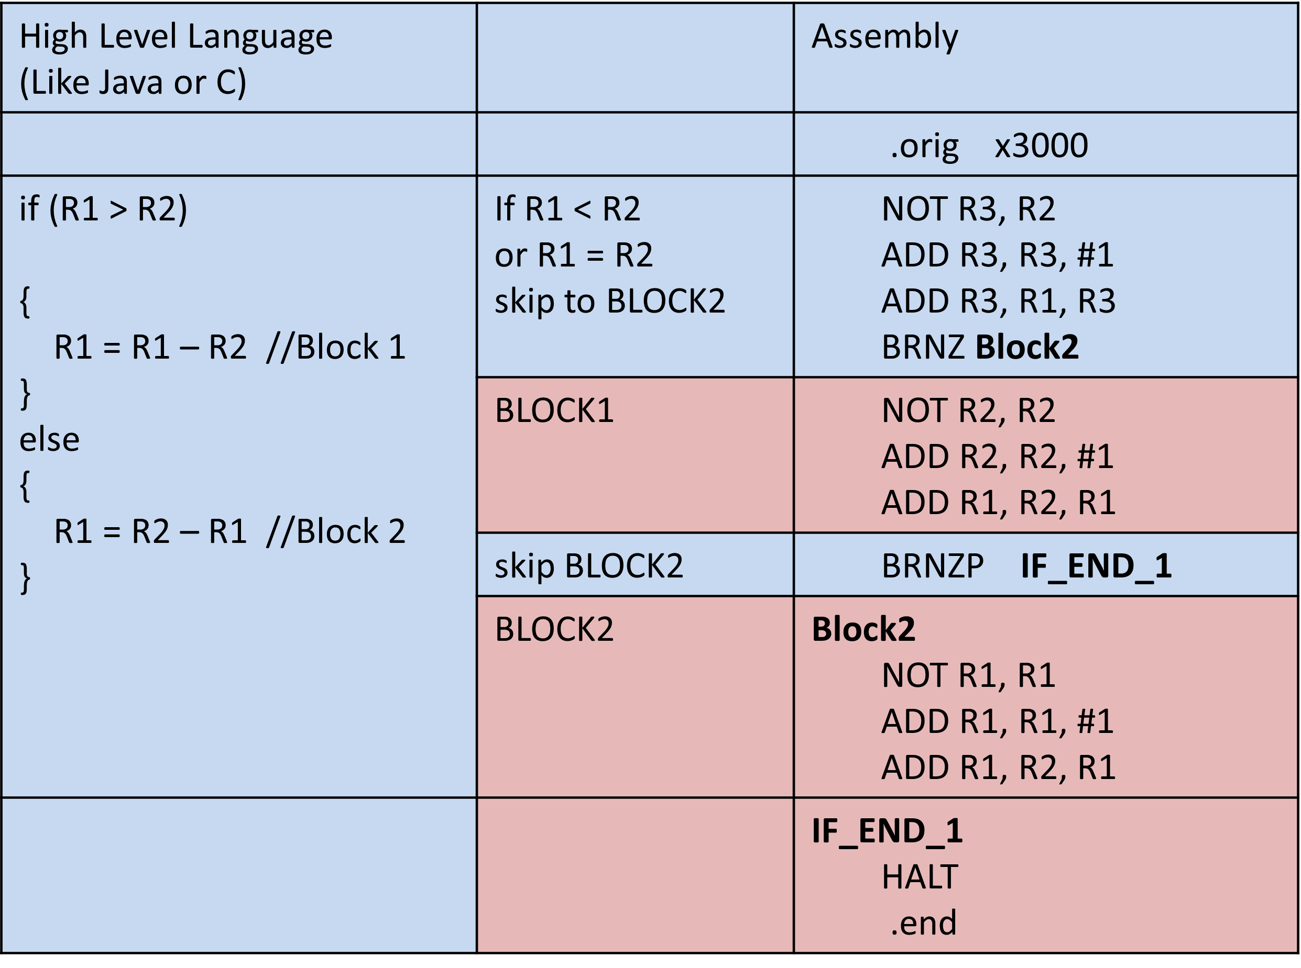
If – Else with Labels

Slide 15
Assembly Format
Labels should be all the way to the left margins.
Instructions should be tabbed once.
Pseudo-ops should be tabbed once.
Any operands after the instruction should be separated by one space.
If there is a comma, it should immediately FOLLOW the thing it is separating.
Comments may start on the left margin, be tabbed, or follow the instruction.
Not following these rules can cost points on exams and quizzes.

Slide 16
How to Assemble
Download the assembler.
Open the .asm file.
It will automatically assemble on load or will reassemble when the button is clicked.
Note the lower section of the assembler shows any errors or the last assemble time and date.
Make sure to check for errors when assembling.
You can leave the assembler open and have your editor open at the same time for quick update and assemble.

Slide 17
How to Assemble Example
.orig x3000 ;puts the value 3000 as the first line in the hex file
;Code starts here.
MAIN ;Main is a label. No one said you have to use it.
LEA R6, C ;Note no index, only a label
LD R0, A ;Note no index, only a label
HALT ;Stop the program
;The assembler will ignore all blank lines and comments.
;The hex file will not be changed.
;Data section
A .fill 65 ;puts 65 into 3003
B .fill 66 ;puts 66 into 3004
C .BLKW 5 ;puts 0 into 3005, 3006, 3007, 3008, 3009
D .fill 68 ;puts 68 into 300A
;See video on AsULearn
;Last thing in file should always be .end
.end

Slide 18
Assembly Results – The hex file
3000
EC04
2001
F025
0041
0042
0000
0000
0000
0000
0000
0044

Slide 19
JSR and JSRR
Jump Save Return (JSR)
Jump Save Return Register (JSRR)
BOTH SAVE THE RETURN ADDRESS!
JSR and JSRR should ONLY be used if you plan on running a subroutine and RETURNING from that subroutine.
A subroutine is like a method or function. You jump away to do some code, then return.
If you just want to jump somewhere and maybe not return, use JMP or BRNZP instead of JSR or JSRR.
JSR AND JSRR SHOULD ALWAYS BE USED IN CONJUNCTION WITH THE RET instruction.

Slide 20
Subroutines
You can read about subroutines in chapter 9.
A subroutine is like a function or method.
Pass parameters using registers.
Return values using registers.
When using a subroutine, ALWAYS save and restore any registers that you use in the subroutine.
At the beginning of the subroutine save all registers that you use in the subroutine.
At the end of the subroutine, before the RET, restore the registers to their original value.
DON’T SAVE OR RESTORE THE RETURN REGISTER.

Slide 21
Passing Arguments to Subroutines
Two solutions
Store arguments in memory (preferred but a bit complicated).
Store arguments in registers (easy but has drawbacks).
For now we will assume Registers have the arguments.
Most high-level languages store arguments in memory on the stack.

Slide 22
The Register Modification Problem
To work, MULT probably needs to use multiple registers.
But what if the code that needs to USE mult is using the same registers?
What if MULT overwrites an important value in a register that the original code needed?
The code that needs to use MULT is known as the CALLER.
The code that is getting called (MULT in this case) is known as the CALLEE.
To prevent register overwriting either the callee or the caller must save the registers and restore them.

Slide 23
CALLEE vs CALLER
The caller may not know exactly what registers the callee will be using. Therefore, to be safe, the caller would have to save ALL important registers.
The callee, however, knows exactly what registers it needs to perform its function. Therefore the callee knows exactly which registers to save and restore.
In general, the callee saving registers is most commonly used and should be used in this class.
If you are calling a callee and it specifically modifies a register for returning results, it is up to the caller to save the register BEFORE calling the callee.
FOLLOW THESE RULES
Anytime you write a subroutine, the FIRST THING you should do inside of that subroutine is to save (store) the initial value of any register you will be using.
Anytime you write a subroutine, that last thing you should do before returning (RET) is to restore ALL of the registers that you saved.
You should NOT save or restore any register that you are using to pass a result back to the caller.
Anytime you CALL a subroutine, the CALLER must save any registers that it knows will be overwritten by the subroutine.
If you wish to call a subroutine or use a TRAP from inside of a subroutine, the inner subroutine will modify R7 and the outer subroutine will not be able to return properly. ANYTIME you use a subroutine or trap from inside of another subroutine or trap you must save R7 and restore R7 before returning.

Slide 24
How to save Registers
MULT
;Save registers.
;If I am using R0, R1, and R2, I need to save the original
;values. I DON’T need to save R0 because that is where
;the result of my MULT will be stored.
st R1, SAVE_R1 ;Save R1 so it can be restored
st R2, SAVE_R2 ;Save R2 so it can be restored
;Do any code here
;Restore registers
ld R1, SAVE_R1 ;Restore R1 before returning
ld R2, SAVE_R2 ;Restore R2 before returning
;Only return after restoring the registers.
ret
SAVE_R1 .fill 0
SAVE_R2 .fill 0
;Later we will see how to use a stack to save registers.

Slide 25
EXAMPLE
.orig x3000
MAIN
JSR TEST
HALT
;Describe TEST
TEST
ST R1, T_SR1
ST R2, T_SR2
ST R7, T_SR7
;Code
OUT
BRNZP T_END
T_END LD R1, T_SR1
LD R2, T_SR2
LD R7, T_SR7
RET
T_SR1 .fill 0
T_SR2 .fill 0
T_SR7 .fill 0
;A longer example
Save and restore ANY register that gets used in your subroutine.
DON’T save any register that is designated a return register.
Register save labels must be unique to each subroutine.

Slide 26
Rules For Assembly Programs
Here are some rules I am going to require. These are not necessarily always true for assembly programming, but I want you to follow them for easier grading and problem detecting. The tests will be looking for these.
Your program must have exactly one HALT.
The HALT MUST be reached. If your program goes into an infinite loop, it will fail the tests. Run the simulator until HALT is reached.
Each JSR or JSRR should have exactly one RET.
Any call to a subroutine must NOT modify any registers other than stated return registers. You can use any register as long as you save and restore it.

Slide 27
2 Pass Assembly
Pass 1
Read the code and determine addresses.
Associate labels with addresses.
assign5.sym
//Symbol Name Page Address
//---------------- ------------
// A 3006
// B 3007
// C 3008
// MTOP 300D
// MULT 3009
// SAVE_R1 3013
// SAVE_R2 3014

Slide 28
Assembly List file
assign5.lst
(0000) 3000 0011000000000000 ( 2) .ORIG x3000
(3000) 2005 0010000000000101 ( 3) LD R0 A
(3001) 2205 0010001000000101 ( 4) LD R1 B
(3002) 4806 0100100000000110 ( 5) JSR MULT
(3003) F021 1111000000100001 ( 6) TRAP x21
(3004) 3003 0011000000000011 ( 7) ST R0 C
(3005) F025 1111000000100101 ( 8) TRAP x25
(3006) 0008 0000000000001000 ( 9) A .FILL x0008
(3007) 0009 0000000000001001 ( 10) B .FILL x0009
(3008) 0000 0000000000000000 ( 11) C .FILL x0000
(3009) 3209 0011001000001001 ( 22) MULT ST R1 SAVE_R1
(300A) 3409 0011010000001001 ( 23) ST R2 SAVE_R2
(300B) 1420 0001010000100000 ( 26) ADD R2 R0 #0
(300C) 5020 0101000000100000 ( 27) AND R0 R0 #0
(300D) 1040 0001000001000000 ( 33) MTOP ADD R0 R1 R0
(300E) 14BF 0001010010111111 ( 34) ADD R2 R2 #-1
(300F) 03FD 0000001111111101 ( 35) BRP MTOP
(3010) 2202 0010001000000010 ( 38) LD R1 SAVE_R1
(3011) 2402 0010010000000010 ( 39) LD R2 SAVE_R2
(3012) C1C0 1100000111000000 ( 40) RET
(3013) 0000 0000000000000000 ( 51) SAVE_R1 .FILL x0000
(3014) 0000 0000000000000000 ( 52) SAVE_R2 .FILL x0000

Slide 29
Longer Example
A longer example

Slide 30
Concepts from the Simulator
These commands are from the text-based simulator (lc3sim) on student. But these ideas are common to debuggers in many languages and IDEs.
The graphical based simulators have buttons which do the same things as the following commands.
Type help from within lc3sim get a list of the commands.
step - Execute 1 program step at a time. Will go into subroutines.
next - Execute 1 program step at a time. Will run subroutines and return without stepping through them. Treats JSR like a single step.
finish - If you are in a subroutine will execute until the subroutine finishes then go back to step mode.
continue - Will run to the end of the program with no more stepping.
printregs - Lists all your registers and values on the screen.
dump - Lists memory and values on the screen.

Slide 31
Homework 5
USE THE ASSIGNMENT DOCUMENT ON ASULEARN FOR DETAILS ON THIS ASSIGNMENT.

Slide 32
Create GETNUM
.orig x3000
JSR GETNUM
JSR GETNUM
HALT
GETNUM
;Save Registers
; … program code here …
;Restore Registers
RET

Slide 33
Boolean AND
if (A>B && A>C)
{
print(A)
}
Booleans are positional. Must PASS all tests.
If first test fails jump to end of if.
If second test fails, skip to end of if.
Print A
End of if
 | Assume R0<-A, R1<-B, R2<-C | Comments
 | Not R3, R0 Add R3, R3, #1 Add R4, R3, R1 BRZP ENDIF | ;Compare A > B ;leave -A in R3 ;if A<B || A==B
 | Add R4, R3, R2 BRZP ENDIF | ;Compare A>C ;if A<C || A==C
 | OUT | ;Print R0(A)
ENDIF | HALT

Slide 34
Multiple ANDs
if (test1 && test2 && test3 && … && testn) {BLOCK}
if test1 fails jump to END
if test2 fails jump to END
if test3 fails jump to END
if …
if testn fails jump to END
//Execute the BLOCK of code here
END //Move on

Slide 35
Boolean OR
if (A>B || A>C)
{
print(A)
}
Booleans are positional. Must pass either test.
If first test passes branch to Print A.
If second test passes branch to Print A.
Branch to end of if
 | Assume R0<-A, R1<-B, R2<-C | Comments
 | Not R3, R0 Add R3, R3, #1 Add R4, R3, R1 BRN PRINTA | ;Compare A > B ;leave -A in R3 ;if A>B
 | Add R4, R3, R2 BRN PRINTA BRNZP ENDIF | ;Compare A>C ;if A<C || A==C
PRINTA | OUT | ;Print R0(A)
ENDIF | HALT

Slide 36
Another Boolean OR
if (A>B || A>C)
{
print(A)
}
Booleans are positional. Must pass either test.
If first test passes, jump to Print A.
If second test FAILS, skip to end of if.
Print A
End of if
 | Assume R0<-A, R1<-B, R2<-C | Comments
 | Not R3, R0 Add R3, R3, #1 Add R4, R3, R1 BRN PRINTA | ;Compare A > B ;leave -A in R3 ;if A>B
 | Add R4, R3, R2 BRZP ENDIF | ;Compare A>C ;if A<C || A==C
PRINTA | OUT | ;Print R0(A)
ENDIF | HALT

Slide 37
Multiple ORs
if (test1 || test2 || test3 || … || testn) {BLOCK}
if test1 passes jump to CODE
if test2 passes jump to CODE
if test3 passes jump to CODE
if …
if testn passes jump to CODE
BRNZP END
CODE
// Execute BLOCK of code here
END

Slide 38
Mixed ANDs / ORs
if (test1 && test2 || test3) {BLOCK}
if test1 fails branch to T3
if test2 fails branch to T3
BRNZP CODE
T3
if test3 fails jump to ENDIF
CODE
// Execute BLOCK of code here
ENDIF

Slide 39
I will count off points on tests
Setting something to zero when you don't need to.
Not formatting correctly
All labels begin on the left margin.
Instructions and pseud-ops should be tabbed once.
Instructions with multiple fields must have those fields separated by one space.
If a comma is present, it should follow immediately the thing it is separating and be followed by a space.
Not including a .orig or a halt when I ask for an LC3 program.
Not including an initial label or a RET when I ask for an LC3 subroutine.
Loading a positive number with a .fill and then making it negative with code. Just store the negative!
Using two HALT instructions.
Using more than one RET in a subroutine.
Using an offset in an instruction when you should use a label.
Adding more than twice to get some constant. If it isn't possible to add or subtract twice, use a .fill and LD.
Reloading constants that should have been loaded once, especially if it occurs inside a loop.
Using the TRAP instruction instead of the proper assembly word. Use GETC, PUT, OUT, HALT.
Doing anything in a way that is WAY more complicated than necessary. If your code uses advanced features that we did not cover and looks as if you simply copied and pasted something from the Internet, you will receive a zero for the question. I covered the things you needed for this class. The assignments are written assuming you understood those topics. The programs are relatively simple and straightforward. Adding a bunch of unnecessary code or using extremely complicated code shows me that you don't understand what you are doing, and it will be penalized heavily.

Slide 40
When NOT to Clear a Register
In the following cases the value in R0 will be overwritten by the operation.
DO NOT clear a register before GETC.
DO NOT clear a register before LD, LDR, LDI
DO NOT clear a register after an add like this:
ADD R1, R2, #5 (R1 = R2 + 5)
ADD R1, R2, R3 (R1 = R2 + R3)
When to clear registers.
If you are using the register as an accumulator in a loop. Clear the value before the loopl

Slide 41
When to Clear a Register
When to clear registers.
If you are using the register as an accumulator in a loop. Clear the value before the loop.
AND R1, R1, #0 (Clear R1 because you want to start at 0)
TOP ADD R1, R1, R2 (This is summing up a bunch of R2s in R1)
BRN TOP
When using immediate add to load a value as a constant.
AND R0, R0, #0
ADD R0, R0, #10(You want R0 to be 10. For this to work R0 must start at zero)

Slide 42
Summary of Register Clearing
Any time you are adding a value to itself:
R0 = R0 + R1
Where the same register is on both sides of =, you need to think about clearing.
However, this:
R0 = R1 + R2
Simply adds R1 and R2 and overwrites R0 and there is no need to clear R0.

